Slide 1

Non-indigenous species in estuarine environments
Non-indigenous species in estuarine environments
Examples from the Western Scheldt
Sander Wijnhoven
Ecoauthor –
Scientific Writing & Ecological Expertise
www.ecoauthor.net
Guest lecture
University College Roosevelt
11th April, 2018 - Yerseke (NL)

Slide 2
Non-indigenous species in estuarine environments
Definitions
Non-indigenous (NIS), non-native, exotic or alien species:
  Species (subspecies or lower taxon) introduced outside its natural past or present distribution; includes any part (gametes, seeds, eggs, or propagules) that might survive and subsequently reproduce (CBD).
  CBD = Convention on Biological Diversity
  -> Species living beyond their natural range of potential dispersal (i.e. due to human activities).
  Frequently observed nuances in definitions deal with:
  - a historic native range is considered,
- whether climate-change induced dispersal is natural,
- or that national borders or territories are considered.
Invasive species:
  A species whose introduction causes significant economic or environmental/ecological harm or harm to human health.

Slide 3
Non-indigenous species in estuarine environments
The estuary, a potential habitat (for NIS)
What is an estuary?
‘A semi-enclosed coastal body of water which has (temporally) a free connection with the open sea and within which sea water is measurably diluted with freshwater derived from land drainage’ (Pritchard, 1967)
So there is at least: - some salinity difference
- and some tidal influence
  In the North Sea region
  - estuaries are generally shallow, open and dynamic,
  - characterized by (ecologically relevant)
      a salinity gradient
      salinity fluctuations (large and on a daily basis with reasonable tidal differences)
      often supplied with large quantities of nutrients and sediments
      in an environment with natural fluctuations in hydrodynamics
      leading to temporal and spatial alternations in sedimentation and erosion
  The recipe for a diverse landscape with plenty of niches in various developmental (successional) stages

Slide 4
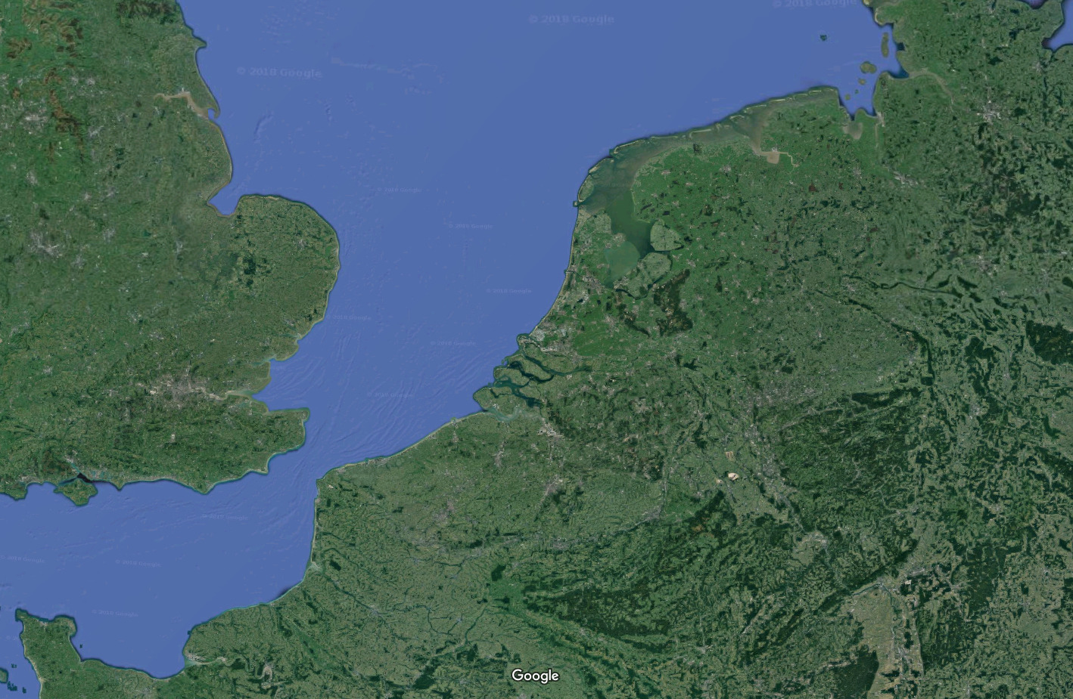
Non-indigenous species in estuarine environments
The southern North Sea region

Slide 5
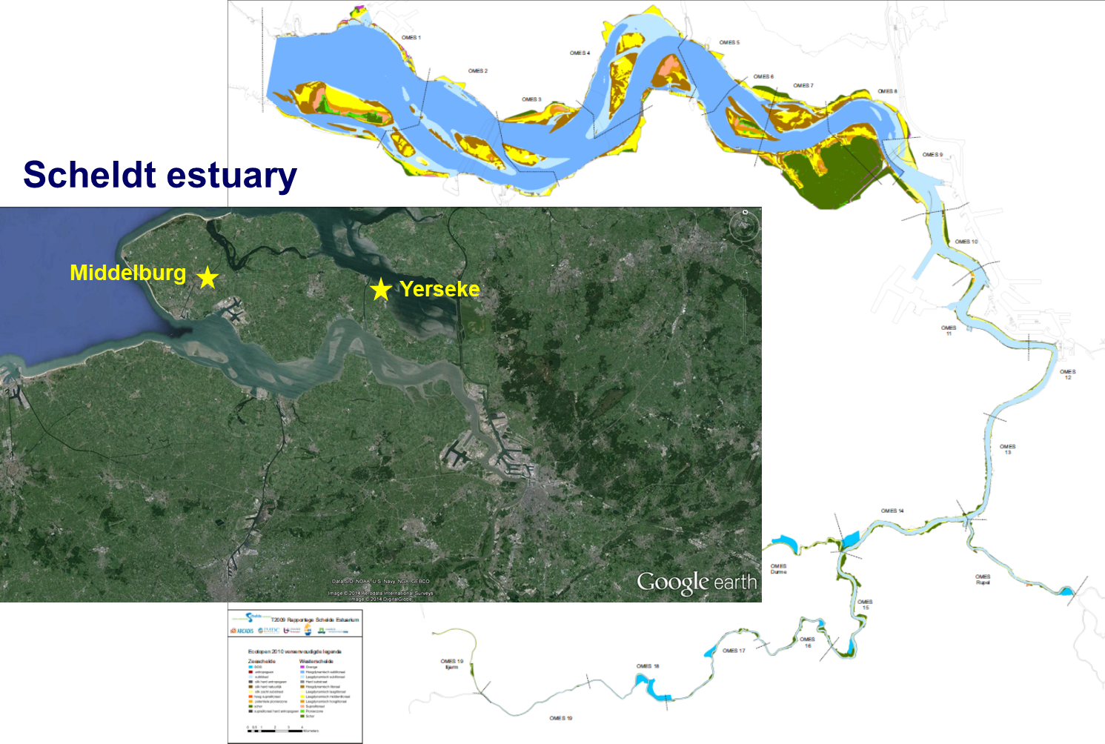
Non-indigenous species in estuarine environments

Slide 6
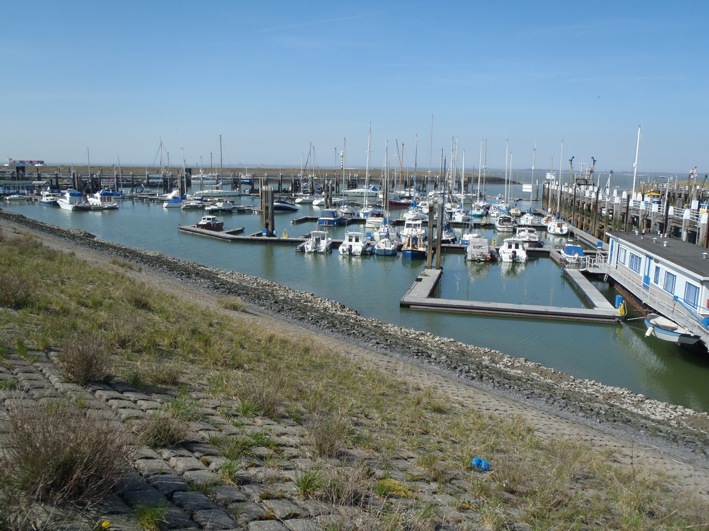
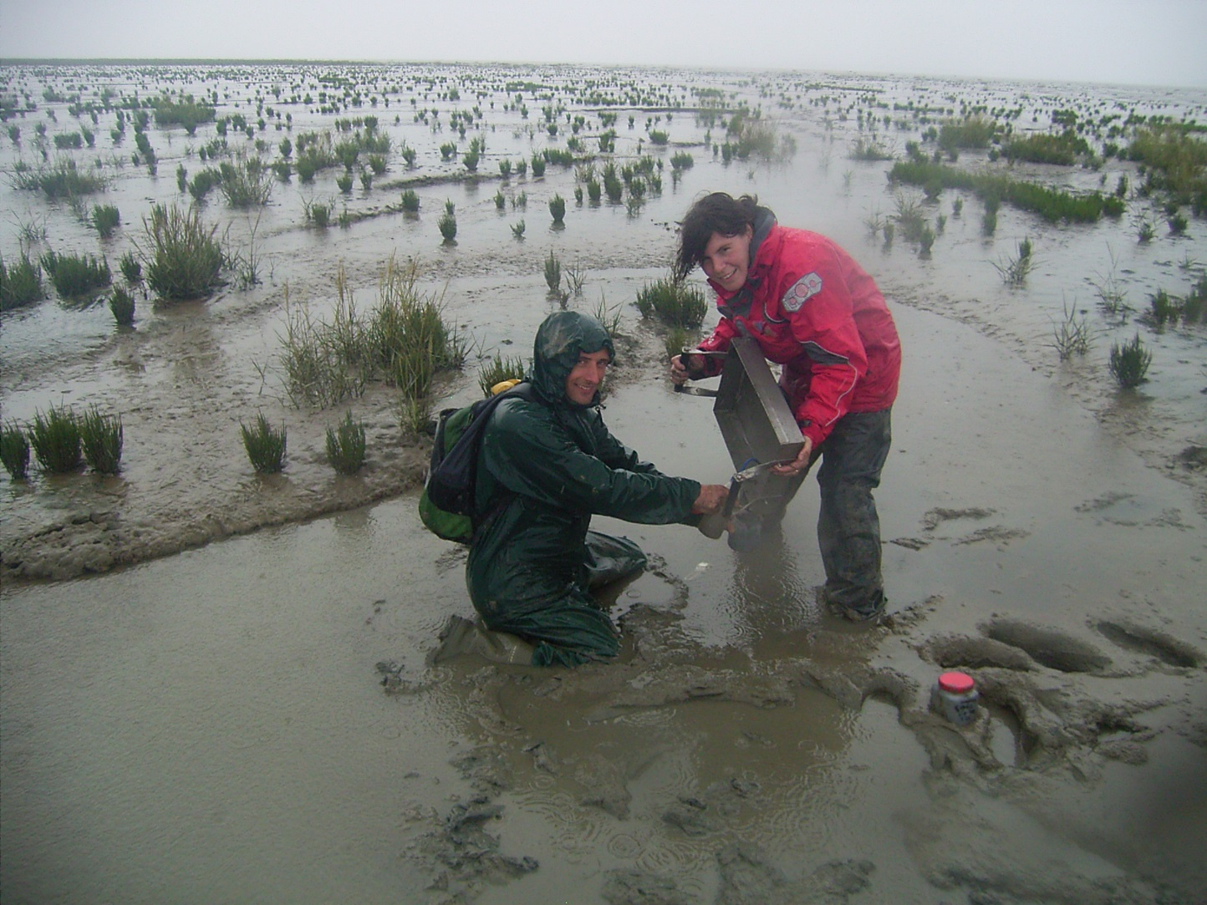
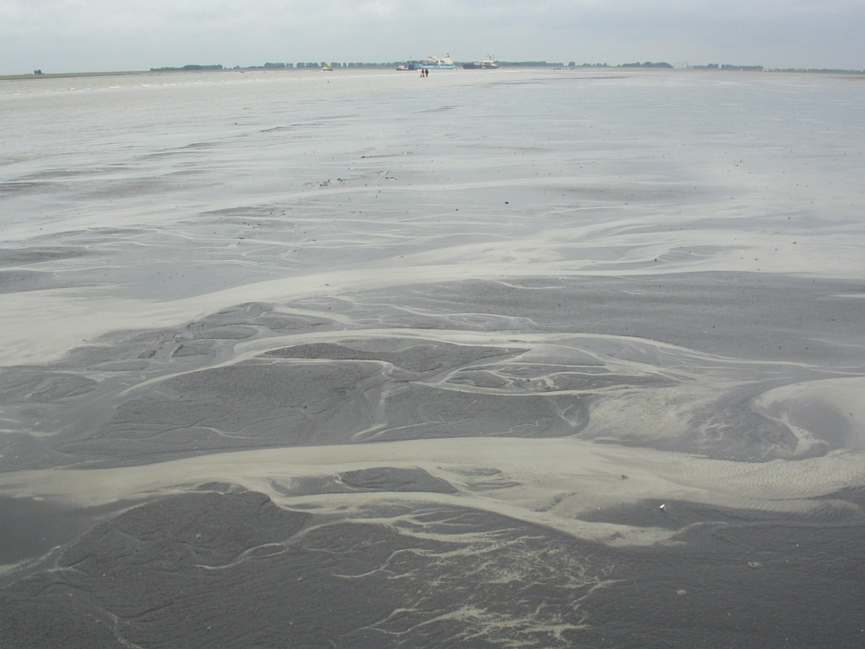
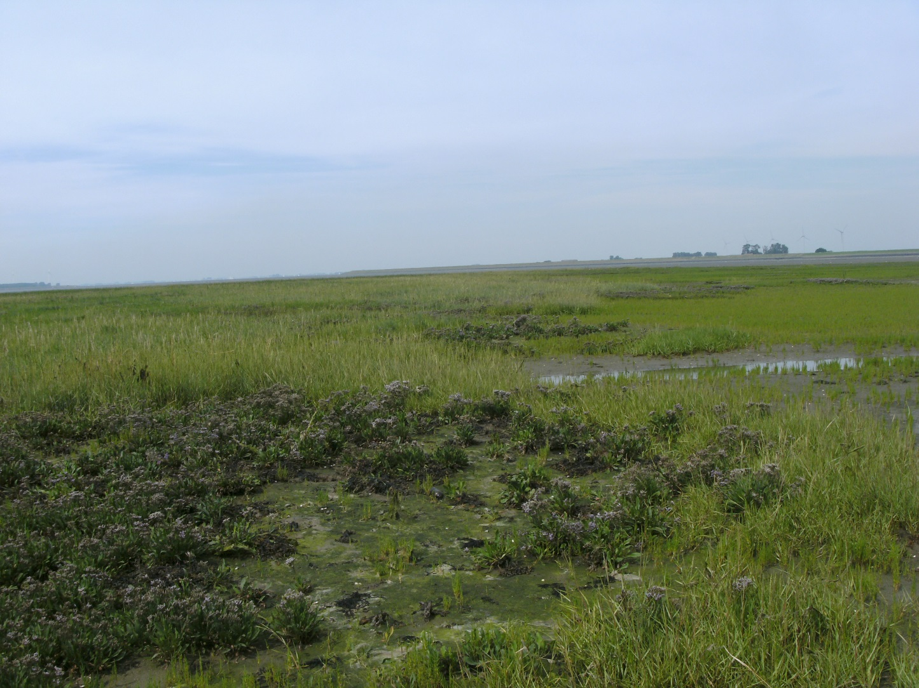
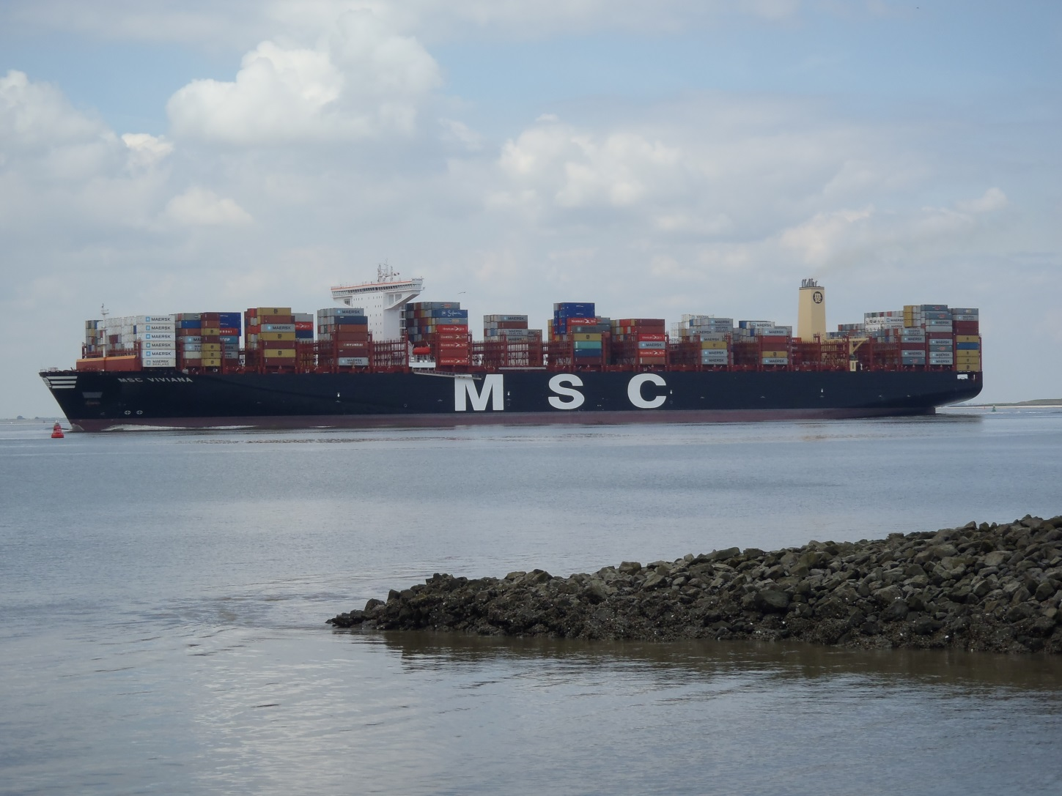
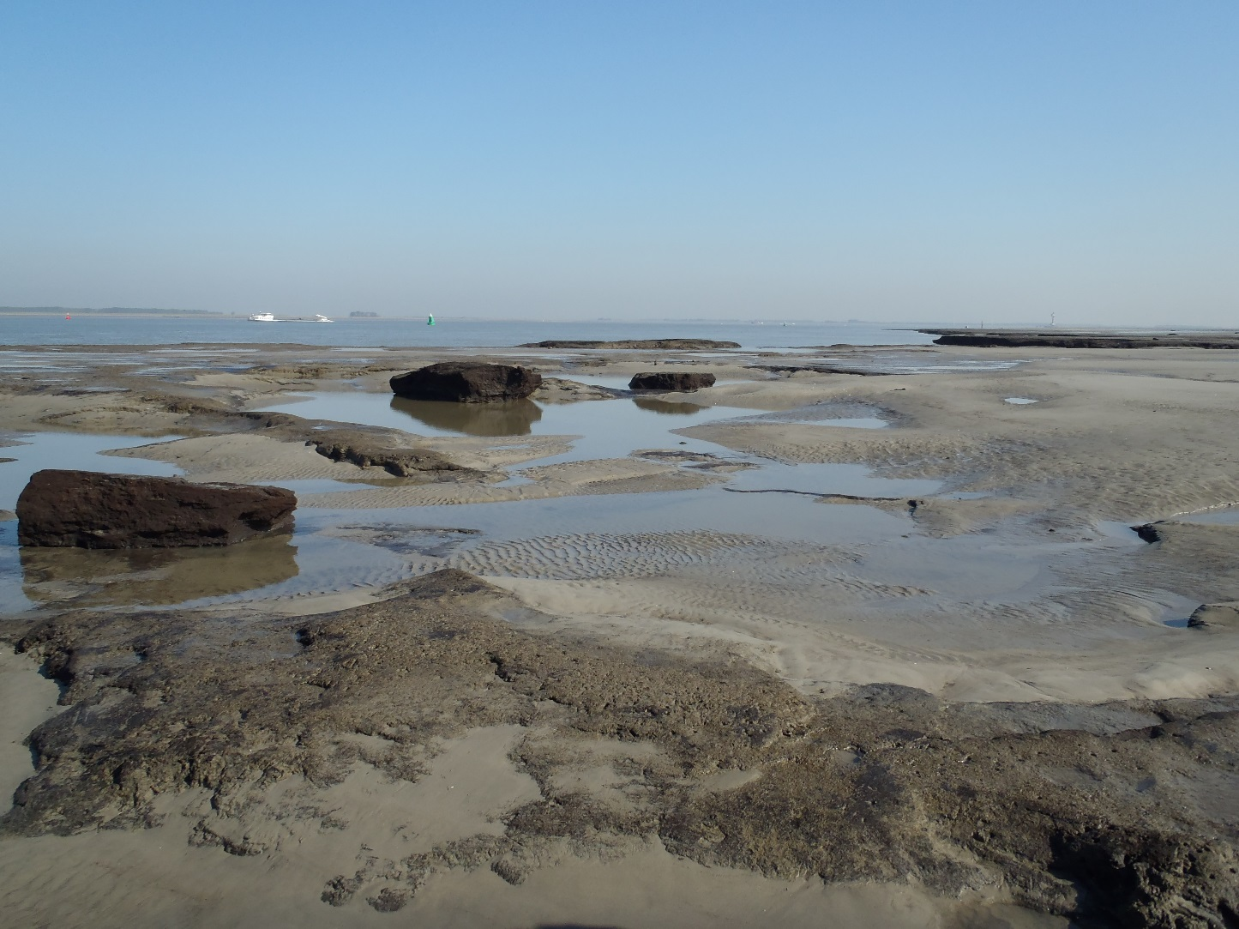
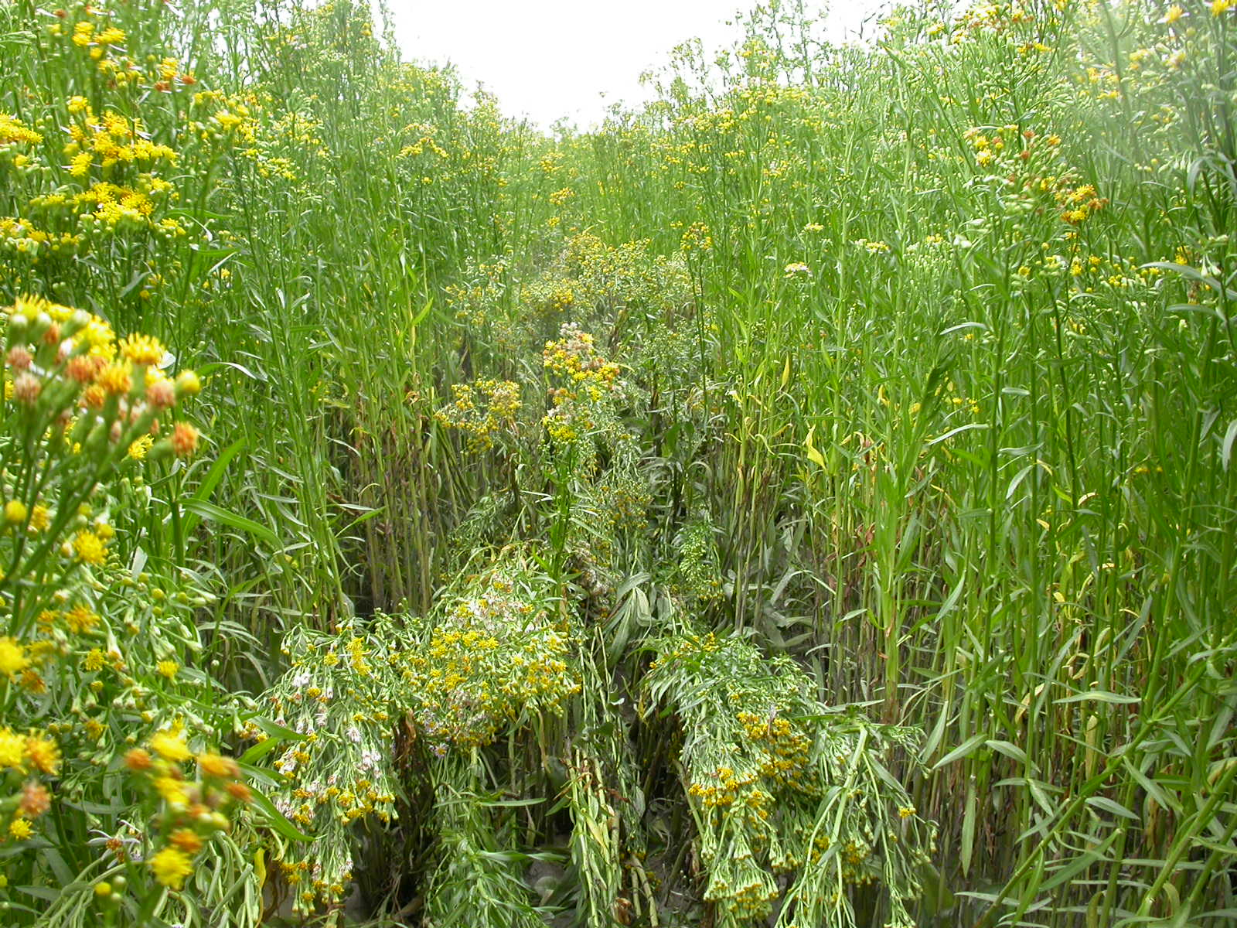
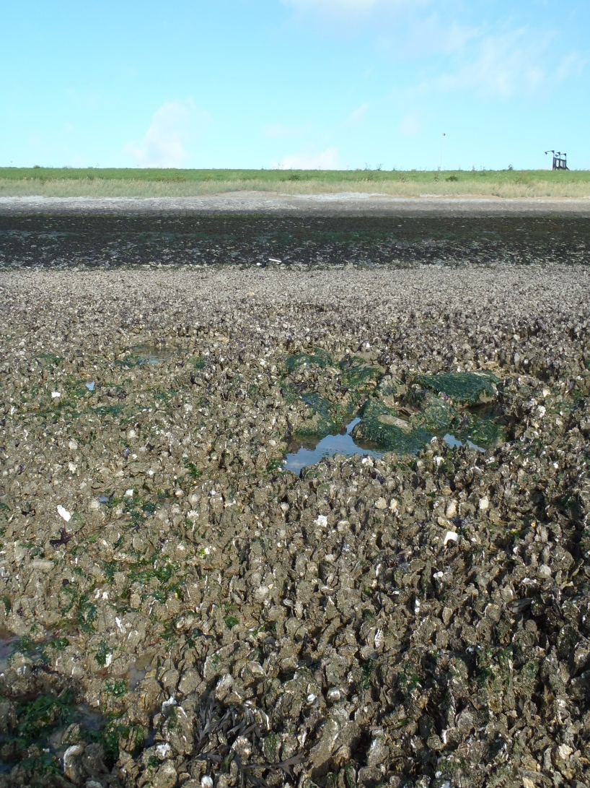
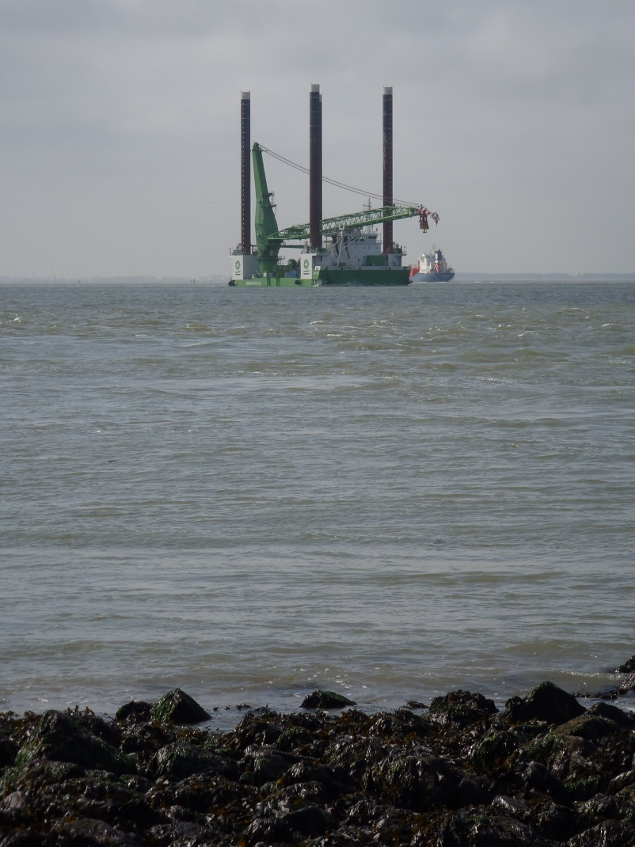
Non-indigenous species in estuarine environments

Slide 7
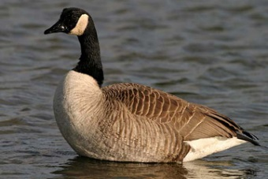
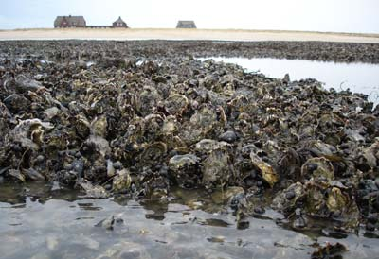
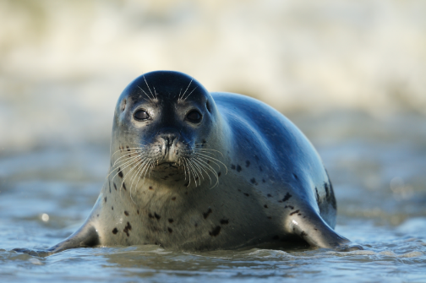
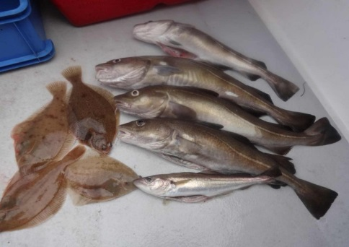
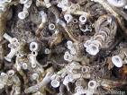
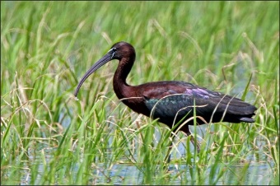
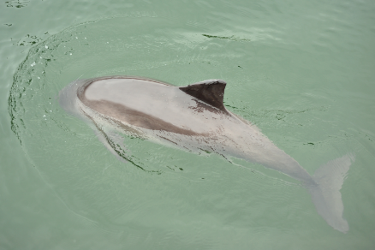
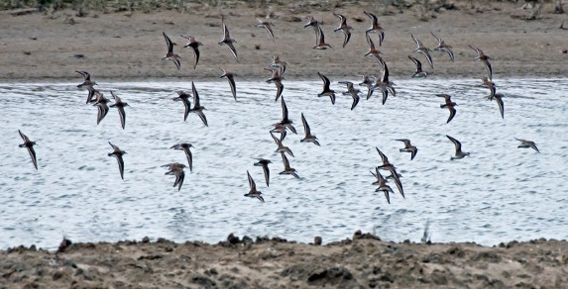
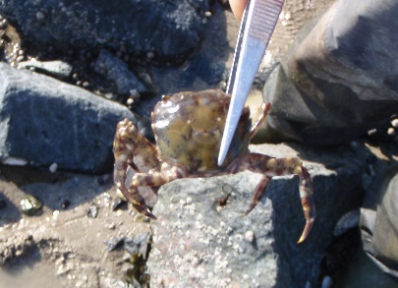
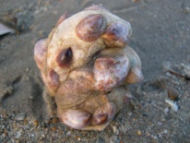
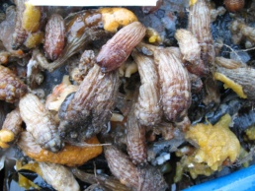
Non-indigenous species in estuarine environments
The estuary, a potential habitat (for NIS)
Relative shallow and good mixing of water layers results in efficient nutrient and element recycling which potentially leads to high productivity.
- Therefore estuaries important habitats for a variety of very specific species
- but also important (temporal) feeding grounds
- or nursery grounds
- and important transition zones (e.g. diadromous fish and
visiting species entering from
either the rivers or the sea)
Magallana gigas
Pacific oyster
Ficopomatus enigmaticus
Tube worm
Hemigrapsus sanguineus
Japanese shore crab
Crepidula fornicata
Slipper limpet
Styela clava
Leathery sea squirt

Slide 8
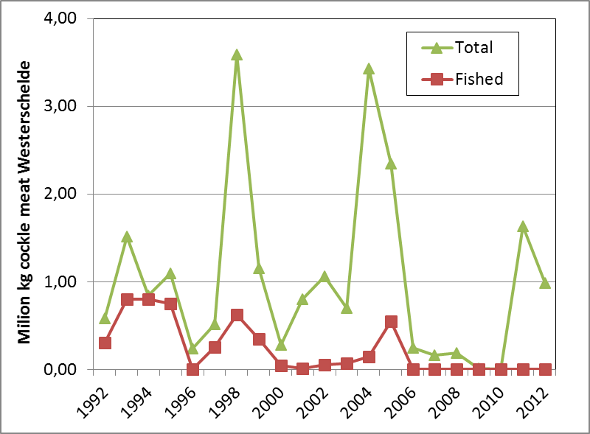
Non-indigenous species in estuarine environments
Total PO₄ (mg/l)
Human activities in estuaries
Estuaries are also where human
impacts and activities accumulate:
  excessive inputs of nutrients,
  sediments or pollutants (incl. thermal)
  resources exploitation (harvesting and fisheries)
  activities like industries and aquaculture
  important transportation and recreational functions (incl. infrastructures)
Because of
  relative easy access and central positioning (relative to land, sea and urbanized areas)
  abundantly available resources
  (e.g. water, nutrients, biomass, energy)
Temperature (°C)

Slide 9
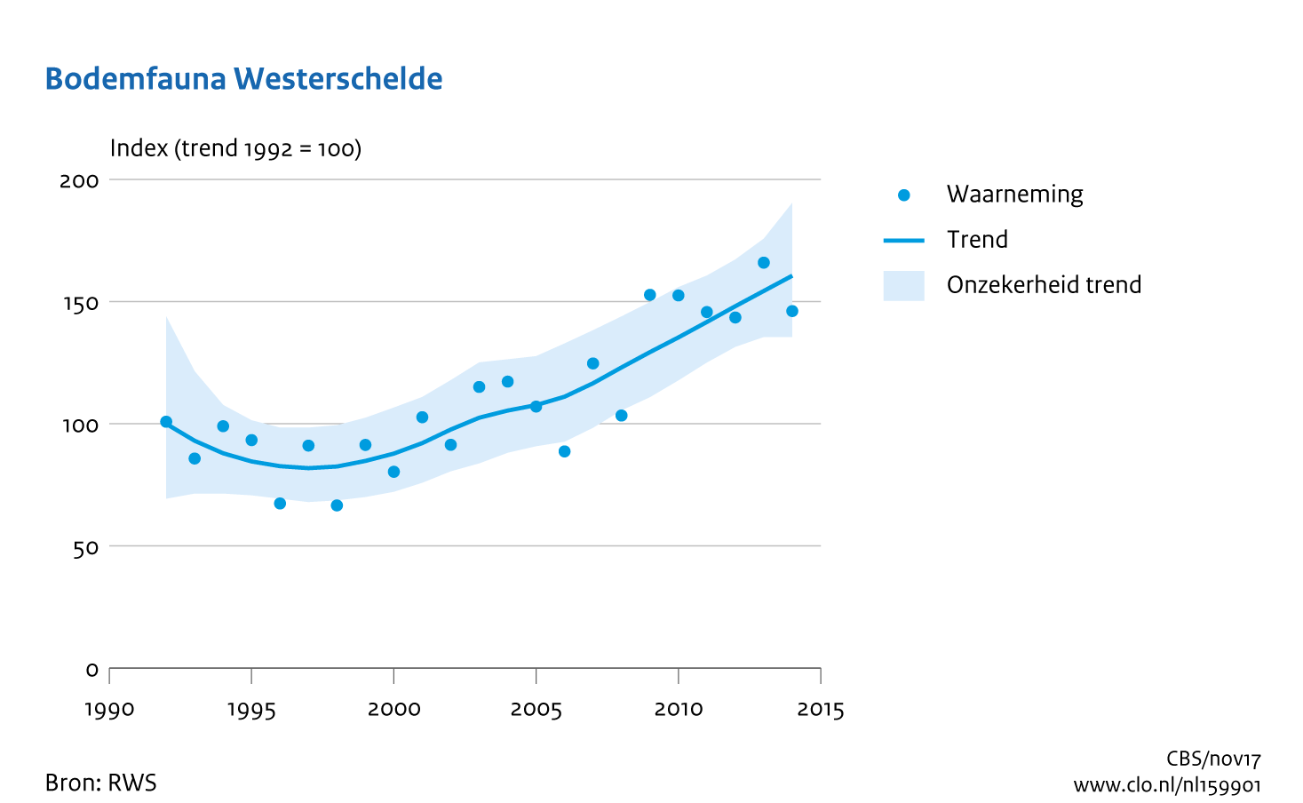
Non-indigenous species in estuarine environments
General developments in the Scheldt estuary
(results of T2009 evaluation)
Improving water quality (although not optimal yet due to large nutrient input)
Increasing hydrodynamics (and turbidity problems upstream)
Total benthos biomass and exotic species numbers cause of concern
Last decennium significant improvement of the benthic communities (as indicated by WNF Living Planet Index)

Slide 10
Non-indigenous species in estuarine environments
Overview of (NIS related) monitoring
Besides potential impact of NIS, information of importance in relation to EU ballast water regulation
A total of 90 NIS of
which 81 still present
(add. 9 fresh water sp.)
Estimated 1 in 8
species is NIS
15 of 19 NIS detected
during 2014-2016 only
present at one location
Reducing efforts to
once every two years
leads to missing 6,3
species that potentially
spread
Early detection gives
options for manage-
ment or eradication

Slide 11
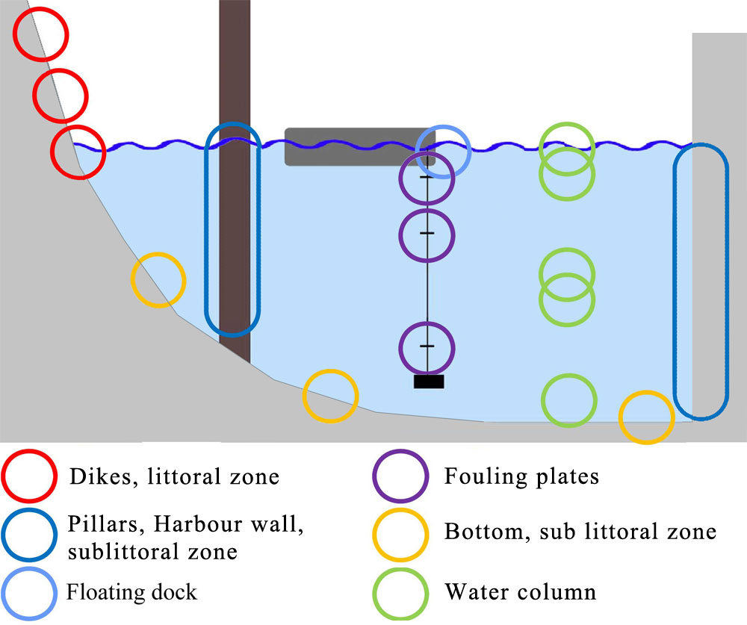
Non-indigenous species in estuarine environments
Within hotspots it is important to monitor all habitats
Species (and/or life stages) harbor different habitats,
that should be inventoried with specific monitoring techniques
Besides early warning, provides information on arrival, distribution and potential impact

Slide 12
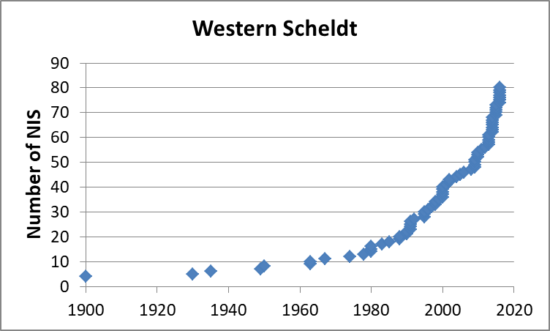
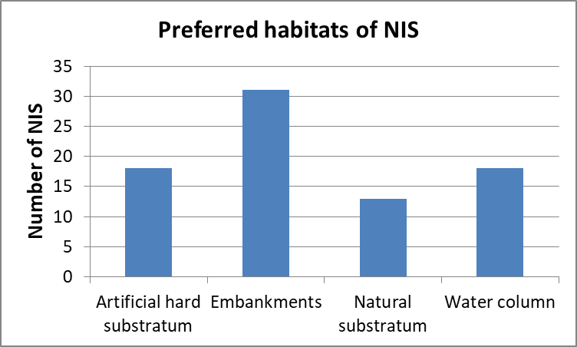
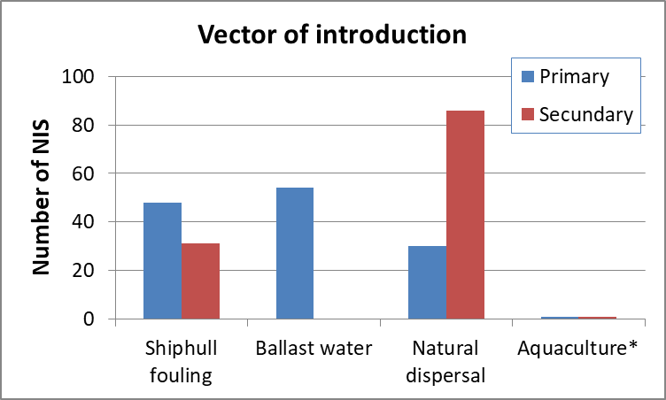
Non-indigenous species in estuarine environments
Patterns in arrival of NIS in the Western Scheldt
NIS seem to profit from improving quality conditions as well
Many species are hard substrate related
Hotspots of arrival are ports and major marinas
Distribution within Western Scheldt often via natural dispersal
Aquaculture not important yet!

Slide 13
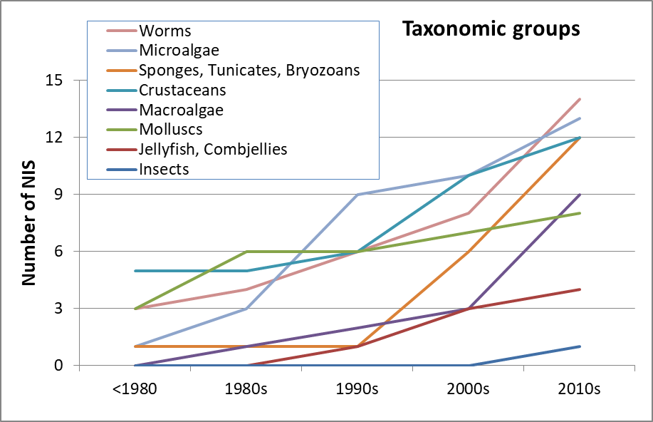
Non-indigenous species in estuarine environments
Patterns in arrival of NIS in the Western Scheldt
Increasing number of molluscs during 1980s,
increasing number of microalgae during 1990s,
more crustaceans and colony-forming species during 2000s,
More
recently
besides
colony-
forming
species
especially
worms and
macroalgae.

Slide 14
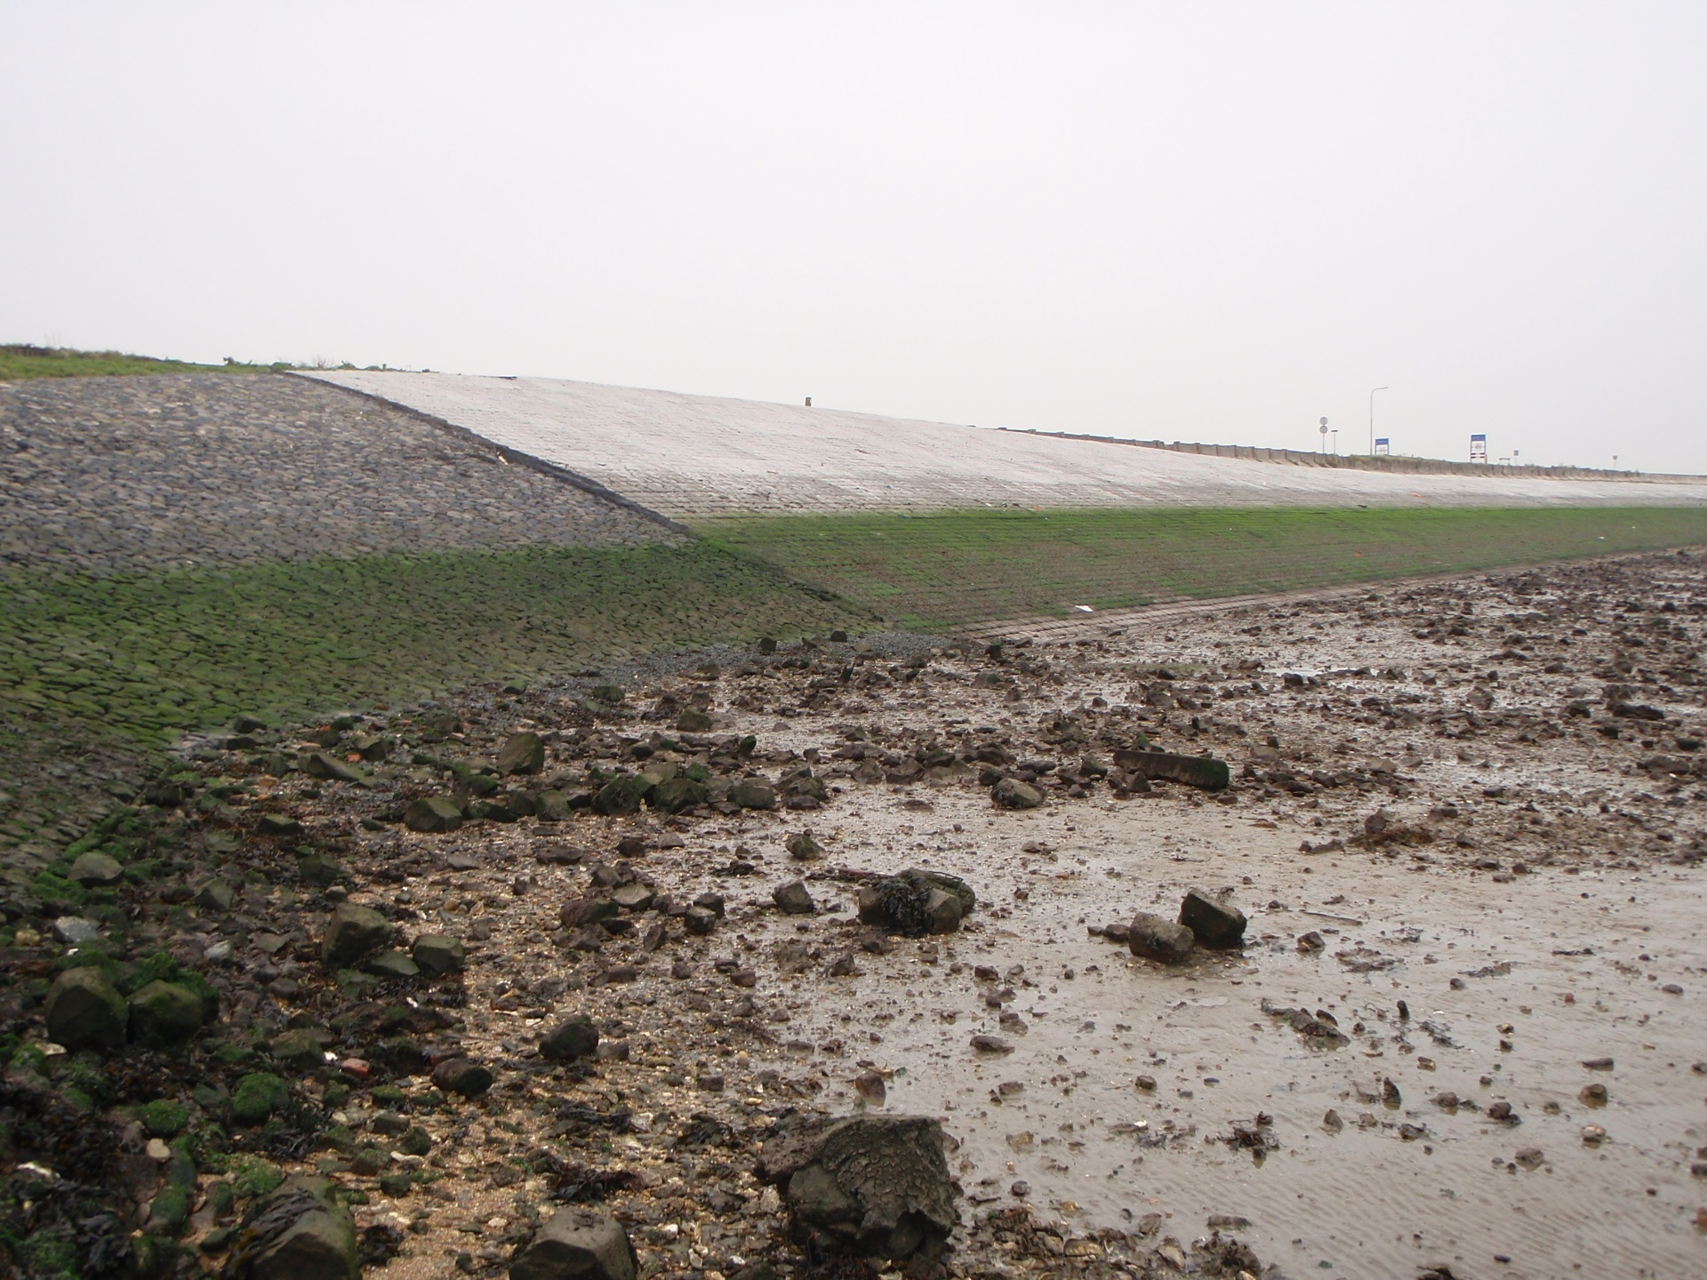
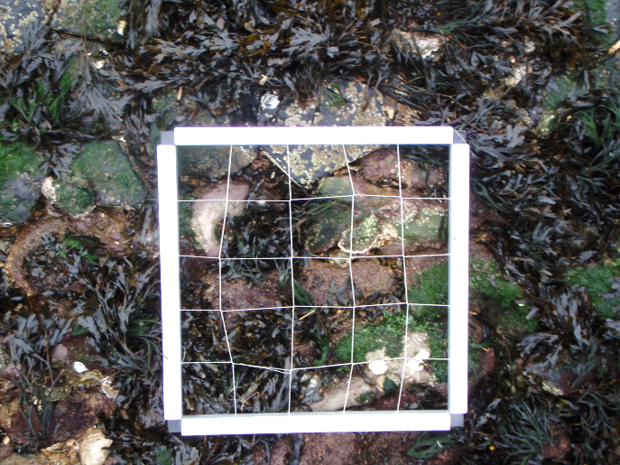
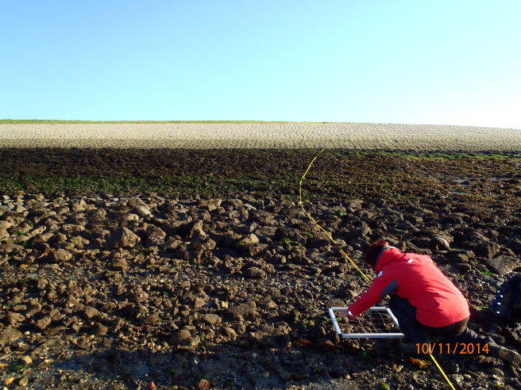
Non-indigenous species in estuarine environments
Transect monitoring
Standardized monitoring to get more insight in population developments and potential impacts of established NIS.
Transects inside and outside marinas
Transect consists of two lines through different habitats
High
Three strata (intertidal)
Middle
Low
Eighteen quadrants (random stratified)

Slide 15
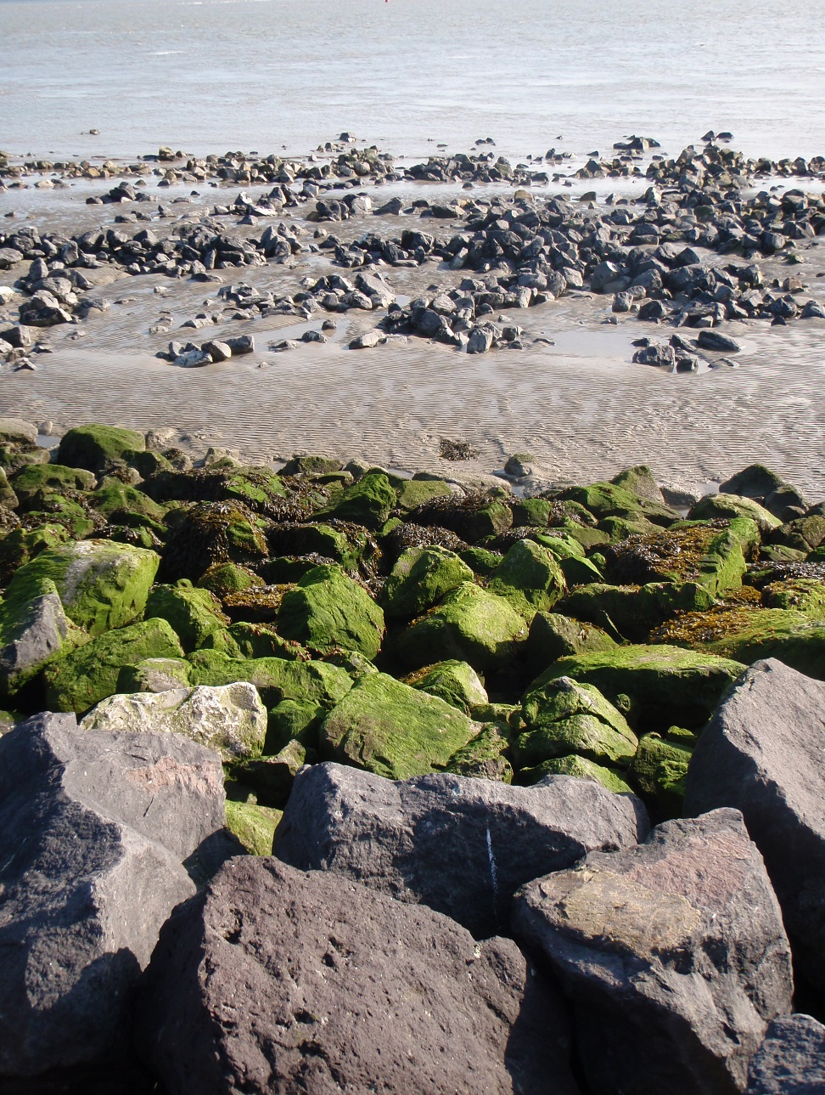
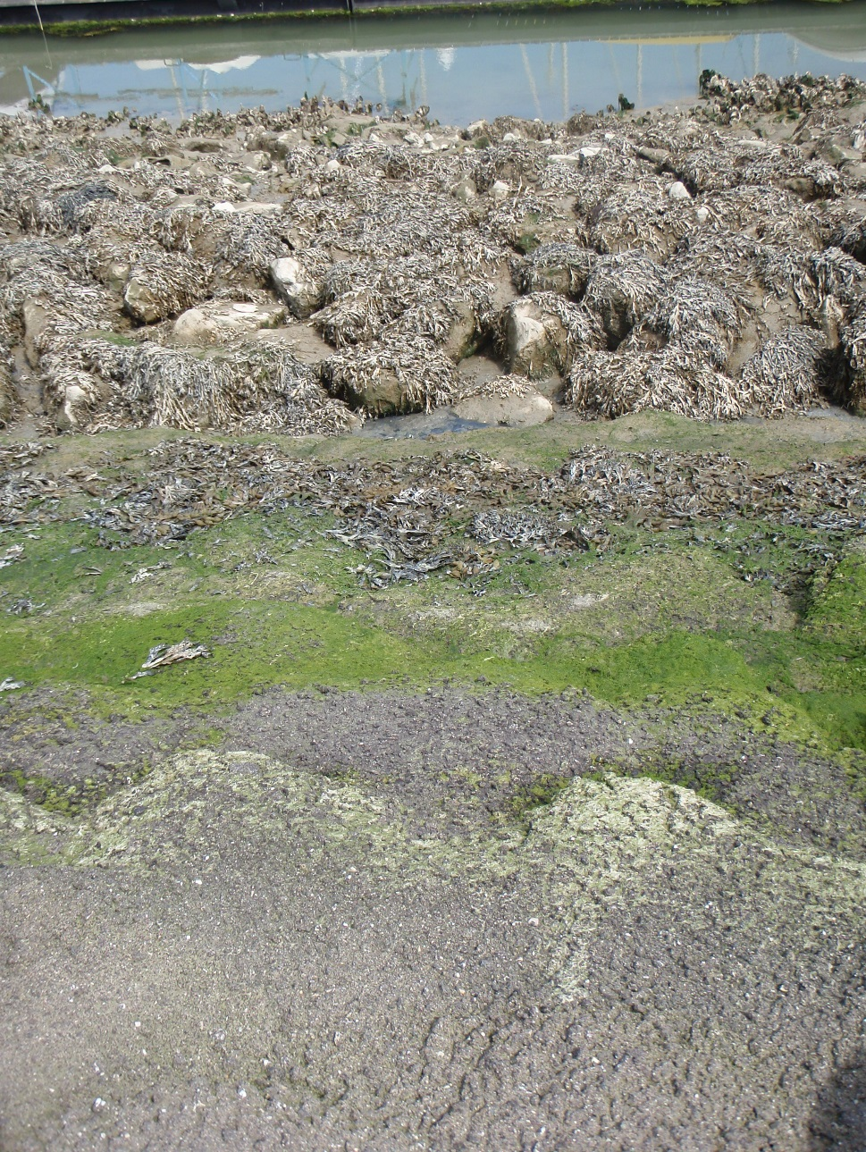
Non-indigenous species in estuarine environments
Transect monitoring: Lines with different substrate
Breskens
Outside marina
Inside marina

Slide 16
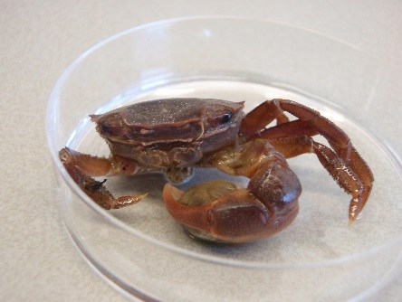
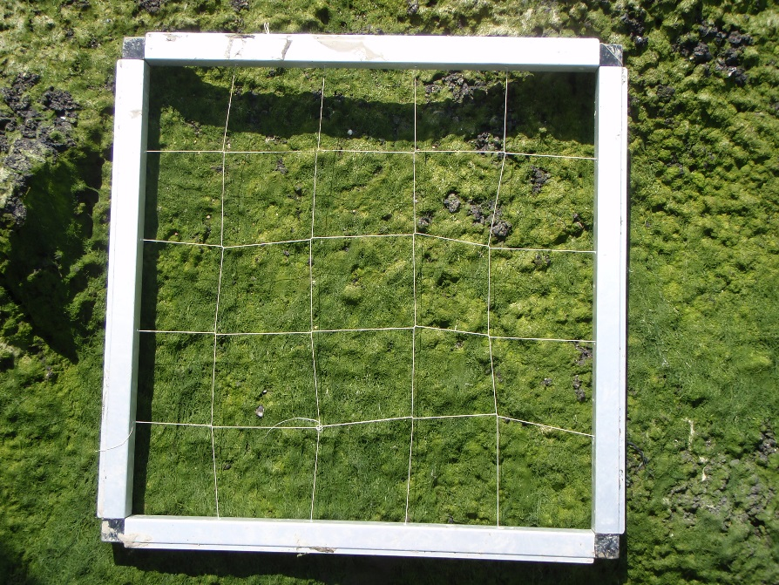
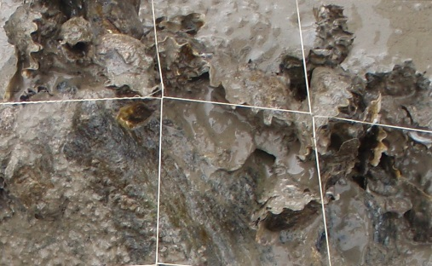
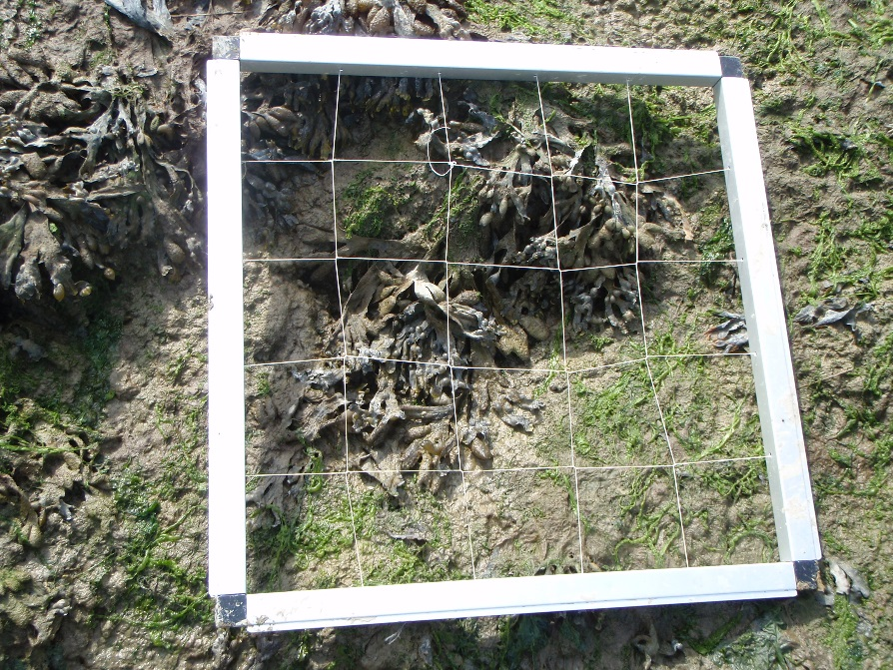
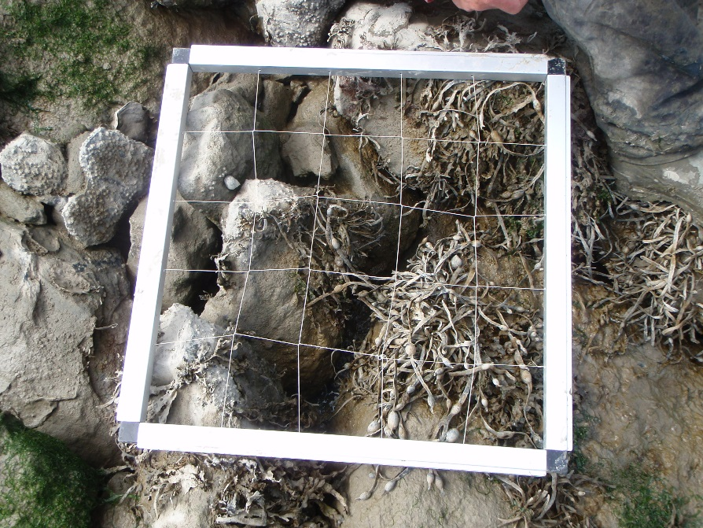
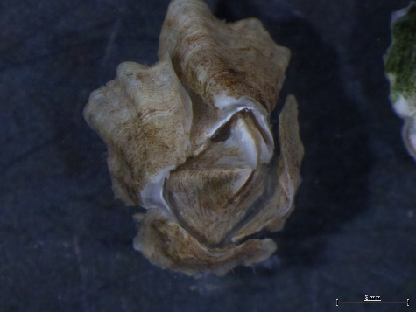
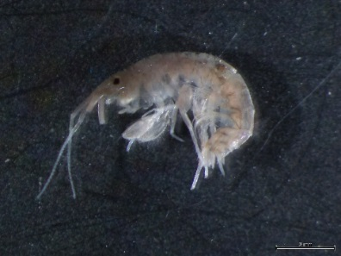
Non-indigenous species in estuarine environments
Transect monitoring: Different quadrants
Hemigrapsus takanoi
brush-clawed shore crab
Breskens
Inside marina
East Asia
High intertidal
Magallana gigas
Pacific oyster
East Australia
Middle intertidal
Austrominius modestus
New-Zealand barnacle
Melita nitida
‘elegant honey gammarid’
North America
Low intertidal

Slide 17
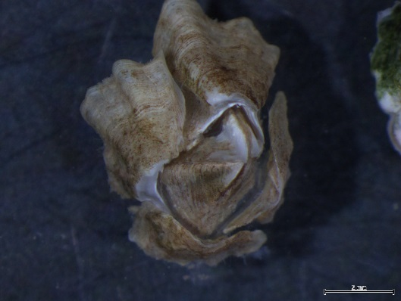
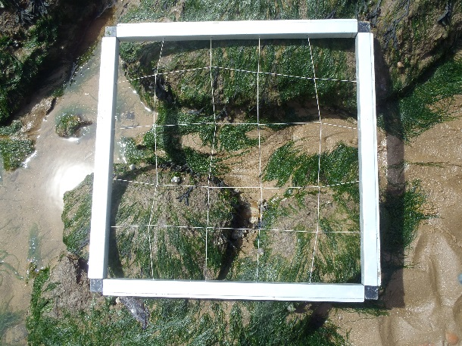
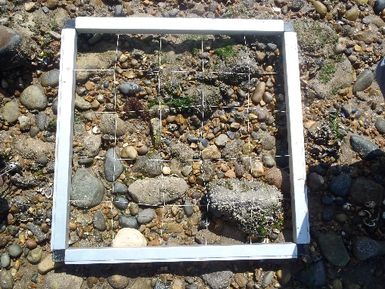
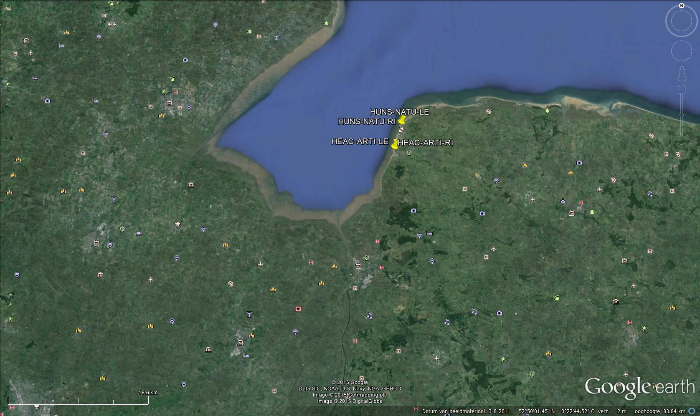
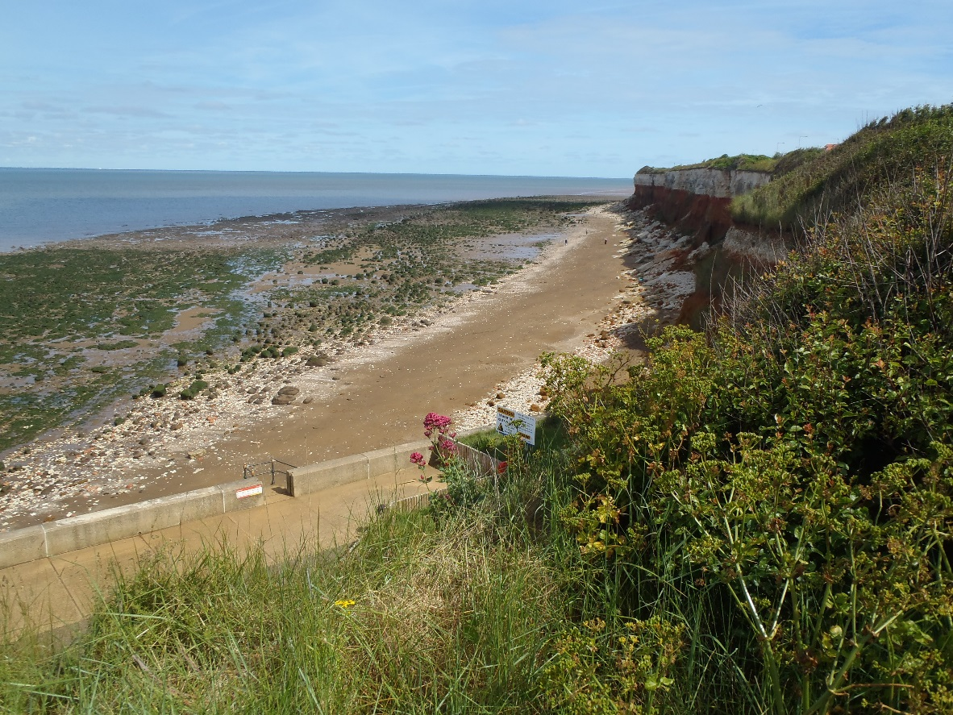
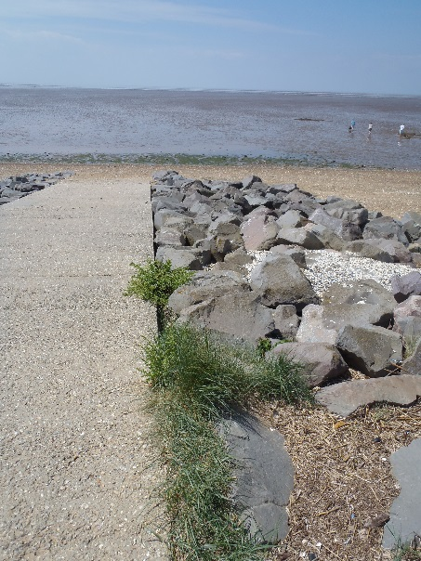
Non-indigenous species in estuarine environments
Transect monitoring: The Wash
Austrominius modestus
New-Zealand barnacle
The Wash
Artificial hard substrate
Natural hard substrate

Slide 18
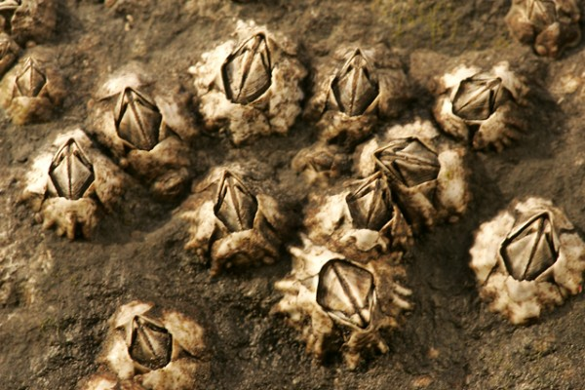
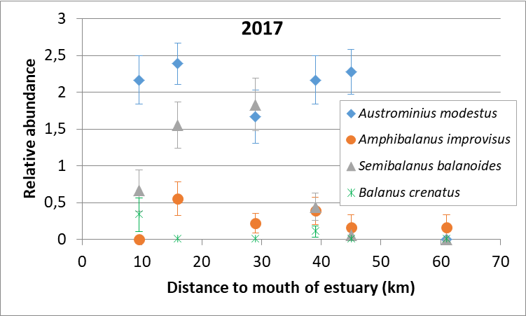
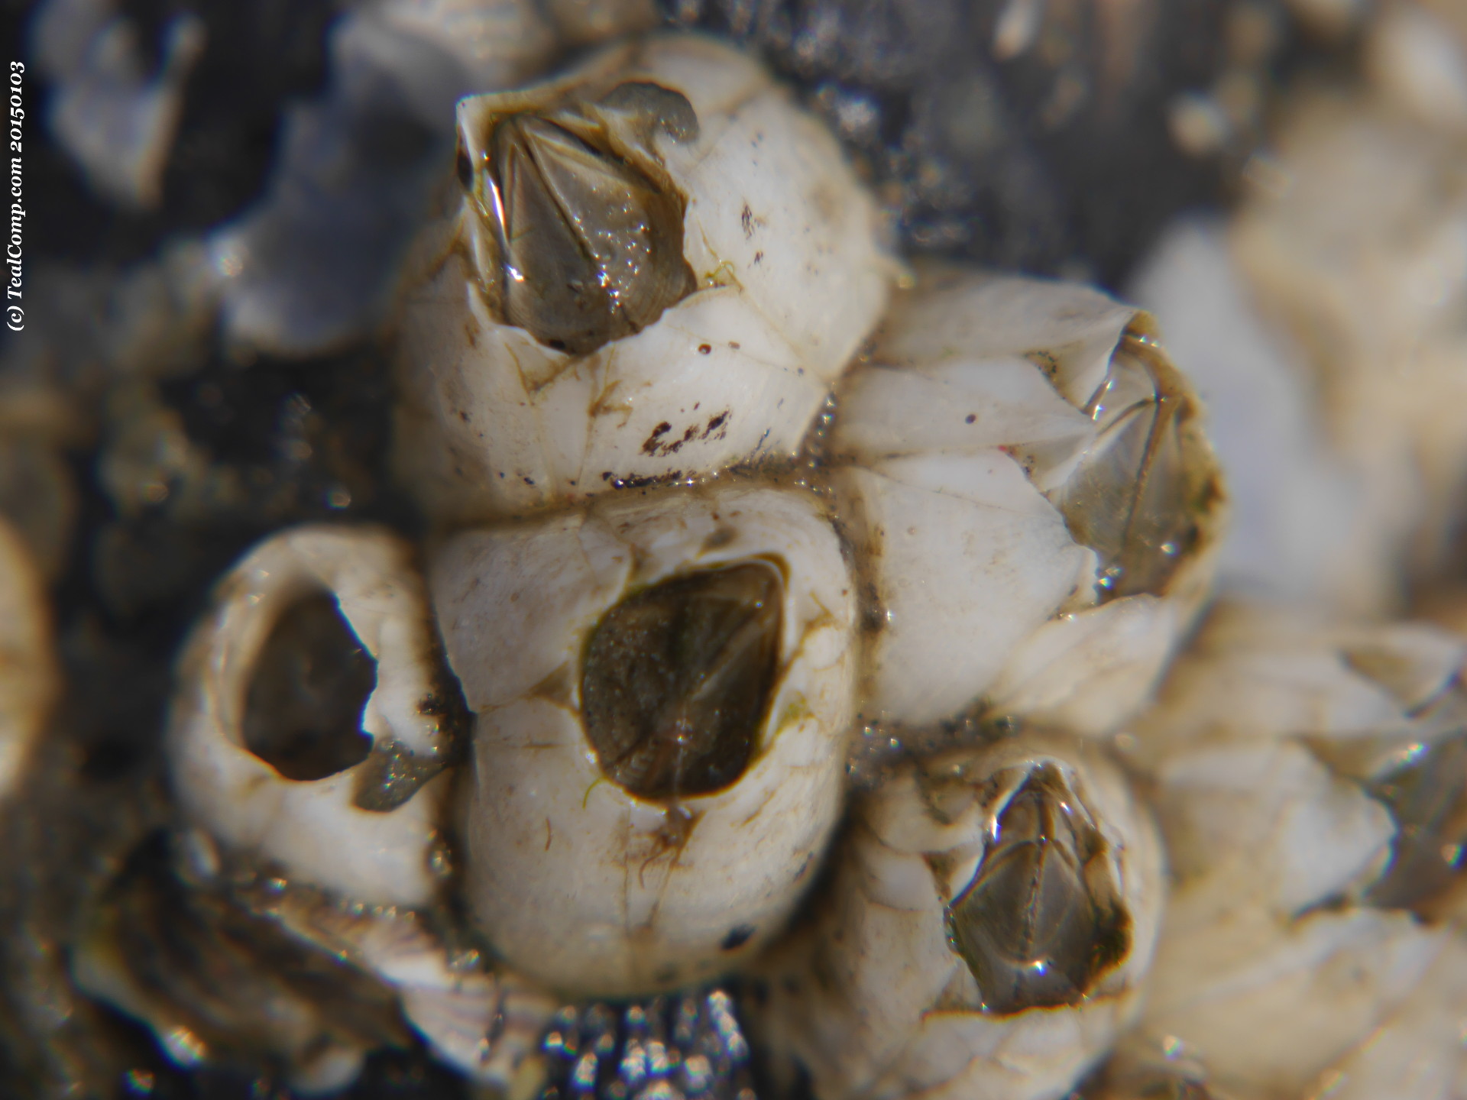


Non-indigenous species in estuarine environments
The barnacle story
New-Zealand barnacle
(non-indigenous; 1943)
bay barnacle
(cryptogenic; probably from NE America; before 1890)
northern rock barnacle
(native)
‘carved barnacle’
(native)
A. modestus often completely dominating
barnacle communities in the Western
Scheldt
A. modestus only lacking at high turbidity
sites upstream in Belgium where A.
improvisus (cryptogenic) is the only barnacle species
-> Loss of biodiversity as A. modestus has taken over the niche of a range of native species
S. balanoides populations seem to increase (largely absent in 2015)

Slide 19




Non-indigenous species in estuarine environments
Does the Pacific oyster accelerate
biodiversity?
Pacific oyster
(non-indigenous; 1964)
Species richness only increases in the presence of oysters if NIS are included.
Native species richness is lower in oyster - than in mussel reefs.
edible blue mussel
(native)
a
A
abc
B
d
B
cd
B
b
A
b
AB
b
B
b
B
There might be a tendency towards lower richness in high density plots for both species

Slide 20



Non-indigenous species in estuarine environments
Competition between shore crabs
We know from an earlier study that H. takanoi largely outcompetes juvenile C. maenas in the intertidal zone
common shore crab (native)
brush-clawed shore crab (non-indigenous;
East Asia; 1999)
Chinese mitten crab
(non-indigenous;
East Asia; 1931)
Japanese shore crab
(non-indigenous;
East Asia; 1999)
Nowadays Dutch delta intertidal crab communities are
completely dominated by H. takanoi (and H. sanguineus at exposed sites).
The fact that C. maenas densities were already decreasing long before the arrival of H. takanoi indicates that the NIS did not initiate the decline.
Van den Brink, Wijnhoven & McLay (2012) J Sea Res 73:126-136

Slide 21



Non-indigenous species in estuarine environments
Competition between shore crabs
Clear niche segregation of species
Juveniles (of all species) typically among filamentous algae in middle and high intertidal zone
C. maenas especially in macroalgae dominated habitats (typical Fucus zone)
H. takanoi especially among oysters and inside marinas
H. sanguineus more a habitat generalist (however especially at more exposed sites)
Correspondence Analysis (CA) of Brachyura relative abundances related to environmental characteristics

Slide 22

Non-indigenous species in estuarine environments
Concluding remarks
There is a clear relation between NIS % and total species richness
  NIS like other species benefit from improving conditions
There are however differences
between systems that are the
result of connectivity and the
quality status of the system
NIS likely have more
opportunities to settle and
expand successfully in
disturbed environments
and/or in new (a-typical)
habitat
  (benefit from reduced
  competition)
NIS are not different from
other species (they just
by chance fit well in the
situation)

